Slide 1





PROJECT NAME
Team : Name & Email id Guide:
Disclaimer: The content is curated for educational purposes only.
Notes:
Slides: Prepare a short slide deck (10-12 slides) summarizing the project objectives, methodology, and key results.

Slide 2
OUTLINE
Abstract of the Project
Problem Statement
Proposed Solution
System Architecture
Live Demo of the Project
Embedded Video of Project
Conclusion
Future Scope

Slide 3
Abstract
Stock market analysis plays a crucial role in understanding market trends, volatility, and correlations between different stocks. This project leverages Python libraries such as Pandas, NumPy, and Matplotlib to analyze historical stock market data. The goal is to extract insights from stock price trends, measure volatility, and identify correlations among various stocks.

Slide 4
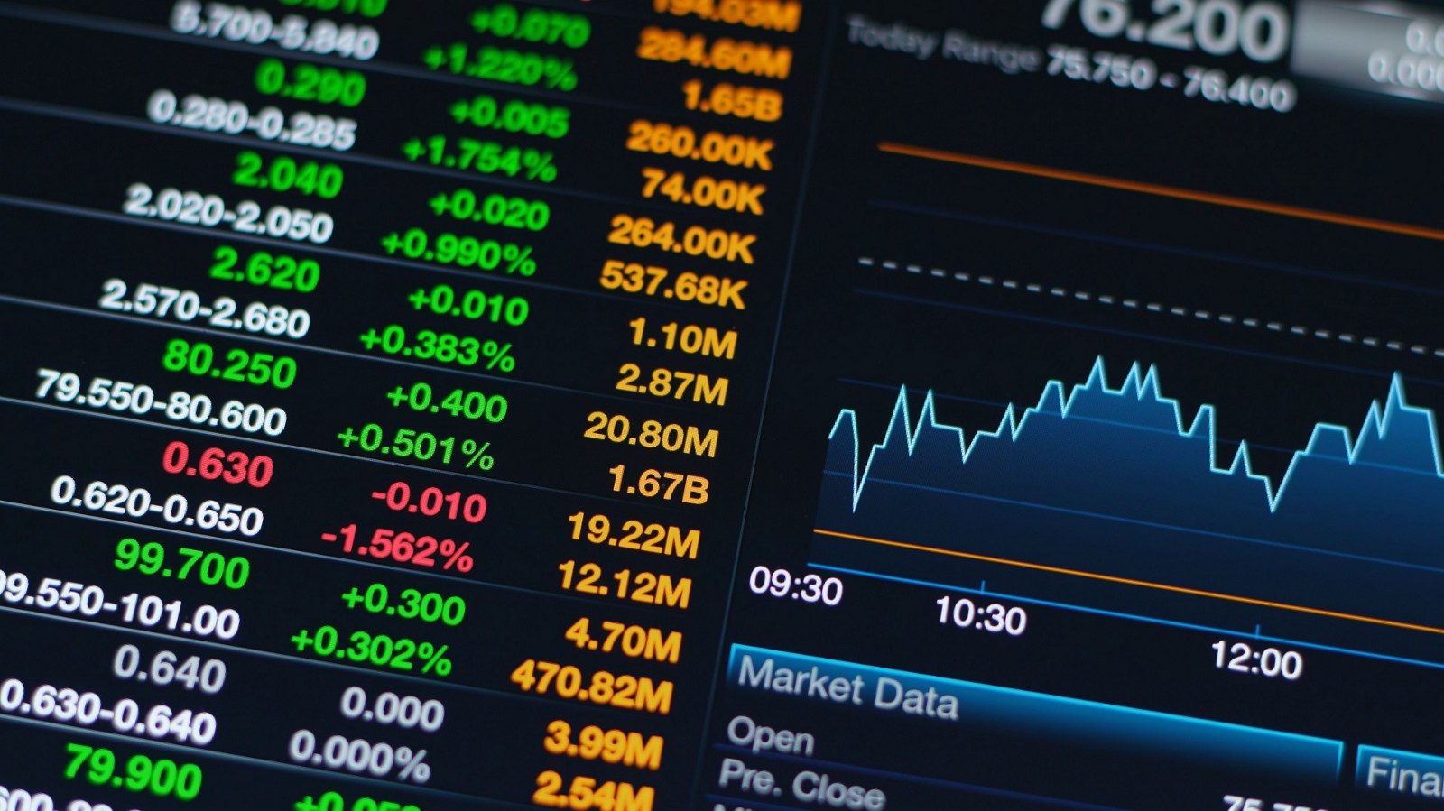
Problem Statement
Investors and traders rely on stock price analysis to make informed decisions. However, analyzing vast amounts of historical data manually is challenging. This project aims to automate stock market analysis using Python, making it easier to identify trends and patterns for better investment decisions.

Slide 5


Proposed Solution
The project will utilize:
Pandas for data handling and processing.
NumPy for numerical computations.
Matplotlib & Seaborn for data visualization.
Correlation & Volatility Analysis for trend detection.

Slide 6
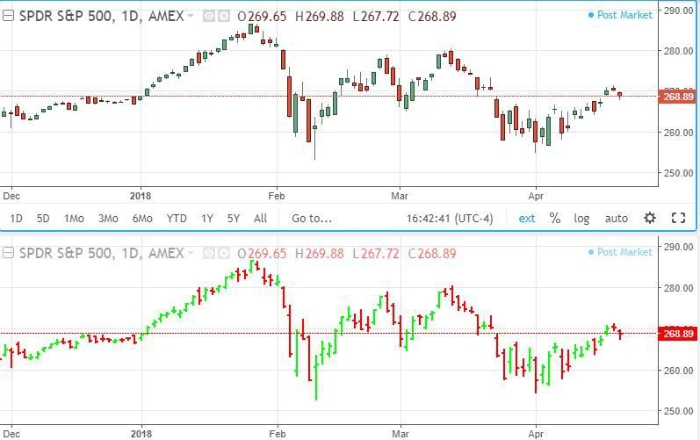
System Architecture
Data Collection: Fetching historical stock prices using the Yahoo Finance API.
Data Preprocessing: Cleaning and structuring data using Pandas.
Analysis:
Time-series visualization of stock prices.
Calculation of moving averages and volatility.
Correlation analysis between different stocks.
Visualization: Graphs and charts displaying stock trends and correlations.

Slide 7
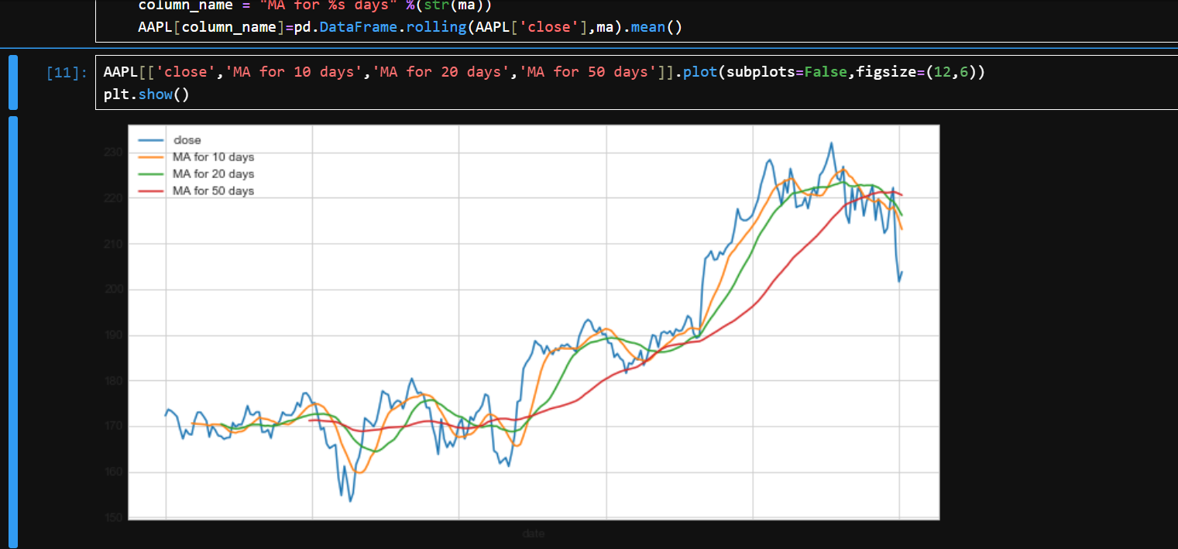
Live Demo of Project

Slide 8
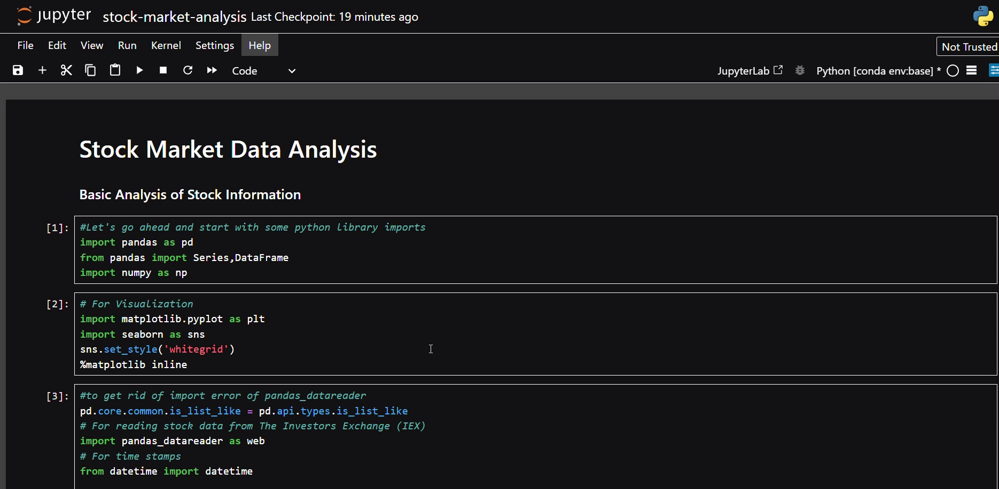
Video of Project Demo

Slide 9
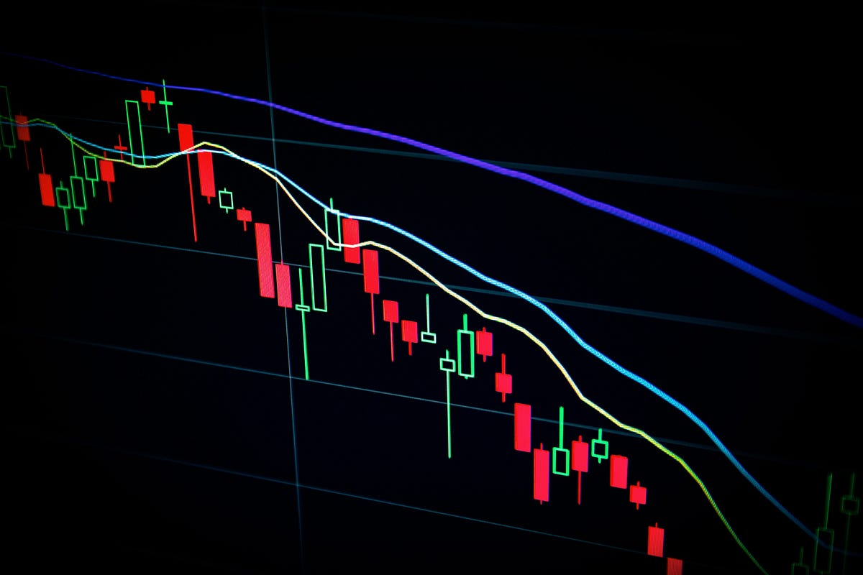
Conclusion
The project provides an automated approach to analyzing stock market trends, helping investors make data-driven decisions. The use of Python libraries makes it efficient to process and visualize stock data.

Slide 10
Future Scope
Integration with real-time stock data for live analysis.
Implementation of machine learning models for predictive analytics.
Deployment
Analysis provides macroeconomic insights.
Technical Analysis offers statistical tools for price prediction.
A well-rounded approach combining both leads to better trading success.

Slide 11
Prepared by: SHRINIDHI PANDIT T.Y.BTECH CSE C-16
Thank you!
References:
https://in.tradingview.com/chart/eaEVWYGI/?symbol=OANDA%RUSD
https://www.babypips.com/
Book: Encyclopedia of Chart Patterns” by Thomas N. Bulkowski
Book: “Technical Analysis Explained” by Martin J. Pring
Notes:
thank you very much for joining this PPT, keep learning.
11

